Slide 1


Demo Session No.: Course Name: Course Code: Instructor Name: Duration: 50 Minutes Date of Conduction of Class:
Conditionals

Slide 2
Reflect on the responses of post session activity
Respond to fun scenario questions:
“If it rains today, what will you do?”
“If you won a lottery, what would you buy first?”

Slide 3
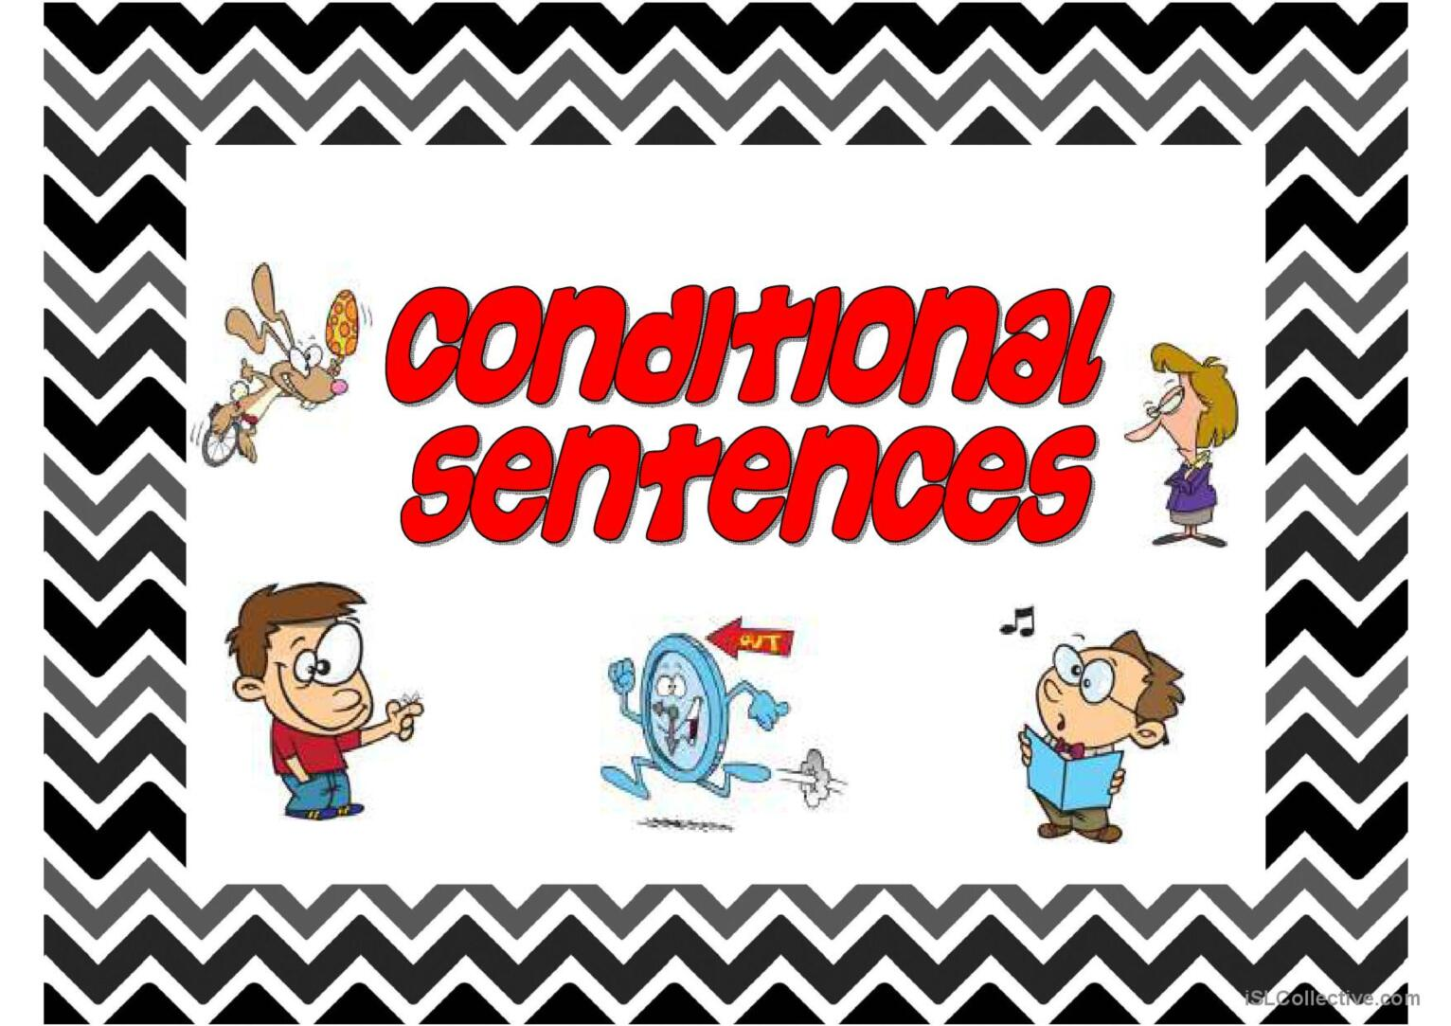

Slide 4
Session Outline
1 Introduction of the Conditionals
2 Rules
3 Activity
4
5
6

Slide 5
At the end of this session students will be able to
Learning Outcome : Identify and correct errors related to conditionals in sentences.

Slide 6
Rules and Tips

Slide 7

Zero Conditional: Facts & Universal Truths
Structure: If + Present Simple, Present Simple
Example: If water freezes, it turns to ice.

Slide 8

First Conditional: Real & Possible Future
Structure: If + Present Simple, Will + Base Verb
Example: If it rains, I will take an umbrella.

Slide 9

Second Conditional: Imaginary / Unlikely Situations
Structure: If + Past Simple, Would + Base Verb
Example: If I won the lottery, I would travel the world.

Slide 10

Third Conditional: Unreal Past / Regrets
Structure: If + Past Perfect, Would Have + Past Participle
Example: If I had studied harder, I would have passed the exam.

Slide 11
Learning Activity 1:Think-Pair-Share
Task:
Think of 4 conditional sentences (1 from each type) individually
Pair up and discuss your thoughts.
Share key points with the class.

Slide 12
Try writing a short paragraph (3-4 sentences) using conditional sentences.
Learning Activity 2
Creative Writing Challenge

Slide 13
At the end of this session students will be able to
Learning Outcome : Identify and correct errors related to conditionals in sentences.

Slide 14
Reflection- Understand the correct use of conditionals through collaboration, humor, and real-world application.
Learning Activity 2

Slide 15
Student Activity:
Complete an exercise sheet filling blanks with the correct form of verbs.
If water ___ (freeze), it turns to ice.
If I ___ (be) you, I would take the job.
If he had studied, he ___ (pass) the test.

Slide 16
Solving Worksheet
Conditional Sentences Worksheet

Slide 17
Solving Worksheet
Answers: Conditional Sentences Worksheet

Slide 18
Interactive Group Activity (15 mins)
Student Activity:
In groups of 3–4, create original sentences for each type of conditional based on prompts:
“If aliens landed on Earth…”
“If you had wings…”
“If you had prepared for the exam…”

Slide 19
Conclusion
Mastering conditional sentences improves clarity and precision in communication. Each type expresses a different time frame or possibility, helping you present ideas accurately.
As you apply these concepts, remember:
✔ Use correct verb tenses for each conditional type.
✔ Choose the right structure for real, hypothetical, or impossible situations.
✔ Practice regularly to avoid common mistakes.
Apply parallel structure in writing to ensure clarity and consistency.

Slide 20
Post session activities …………………………………………… Ensure you complete the assessment on time given on GU LMS.

Slide 21
Information about the next lesson

Slide 22


